Slide 1
Real Estate Management system
NAME:
VTU:
COURSE CODE:
COURSE NAME:
PROJECT TITLE:
FACULTY NAME:

Slide 2

Introduction
A Real Estate Management System streamlines the processes of managing properties, tenants, and leases. It enhances operational efficiency by automating tasks and centralizing data. This presentation covers essential aspects, including system definition, features, and implementation best practices, tailored to property managers and owners seeking optimal management tools.
The system typically includes modules for property listing management, user registration, booking and inquiry handling, payment tracking, and reporting. By integrating all these features into a single platform, the REMS improves operational efficiency, reduces paperwork, enhances data accuracy, and offers users a better experience.Overall, the Real Estate Management System helps real estate companies, agents, and customers manage properties more effectively through automation, real-time access to data, and improved decision-making capabilities
This Photo by Unknown Author is licensed under CC BY-SA

Slide 3

Overview of Real Estate Management Systems
The Real Estate Management System (REMS) is a web-based or desktop application developed to simplify and automate the management of real estate properties. It provides a digital platform where property owners, agents, and clients can interact and perform various real estate activities such as property listing, searching, buying, selling, and renting.This system allows administrators or agents to add, update, and manage property details including location, type, price, and availability. Customers can browse properties based on their preferences, make inquiries, and complete transactions online. It also keeps records of clients, payments, and property histories, reducing the need for manual documentation. By integrating modules like user management, property management, booking, payments, and reporting, the system ensures efficient handling of data, saves time, and enhances transparency in real estate operations.The REMS is particularly useful for real estate companies and individual agents aiming to modernize their workflow, improve customer experience, and maintain accurate, up-to-date information in a secure and organized manner.

Slide 4
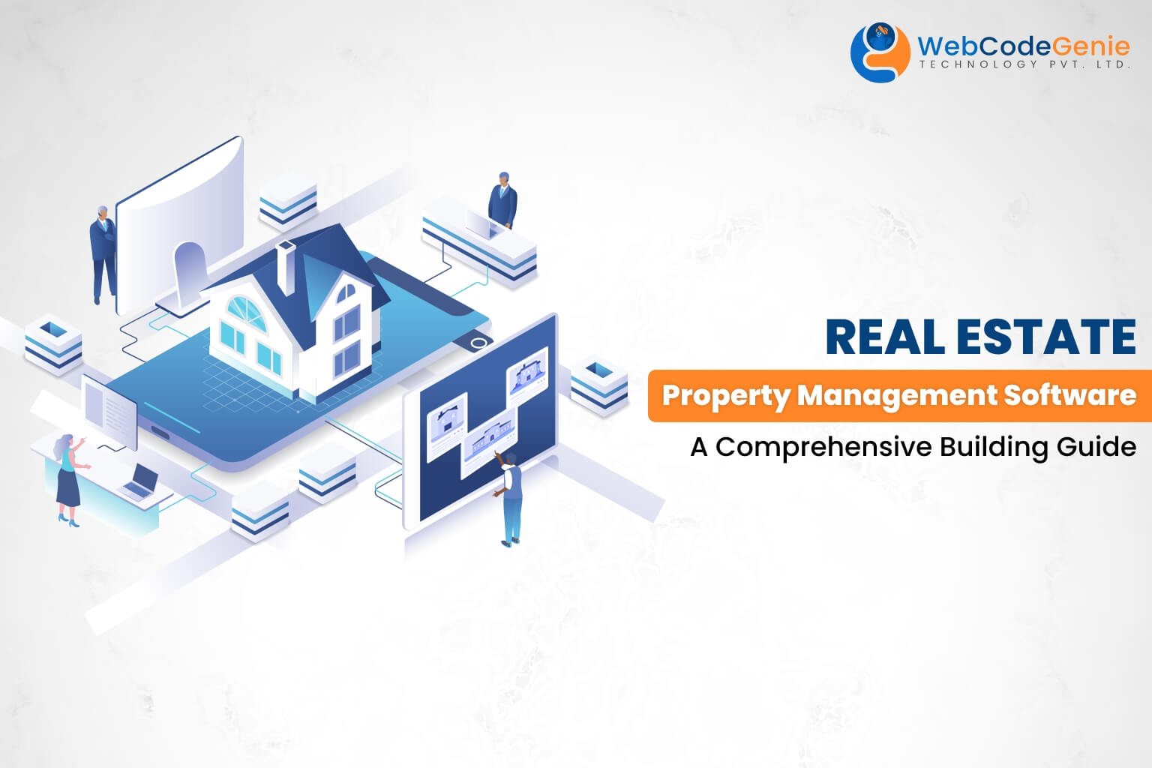
Definition and Purpose
A Real Estate Management System is software designed to handle property operations such as tenant management, lease tracking, and maintenance scheduling. Its purpose is to simplify complex tasks, improve communication, and ensure accurate financial and legal record-keeping, ultimately reducing manual workload and minimizing errors.
The main purpose of the Real Estate Management System
it is to simplify and automate the traditional methods of managing real estate activities.
It aims to:Digitize property management by maintaining an online record of all properties, clients, and transactions.Reduce manual effort and errors in property handling, documentation, and communication.Improve efficiency by allowing real-time access to property information and faster decision-making
.Enhance customer experience through easy property searches, online inquiries, and transparent transactions.Support business growth by providing analytical reports and insights for better management and planning.

Slide 5
Key Features and Functionalities
These systems commonly include tenant databases, rent collection automation, maintenance request tracking, reporting tools, and document management. Advanced features may offer financial analytics, compliance monitoring, and integration with accounting software, all aimed at providing a comprehensive solution for property managers.
User ManagementAllows registration and login for different users such as administrators, agents, and clients.Manages user roles and permissions to ensure secure access.Provides profile management for users to update their information.
Property ManagementEnables agents or administrators to add, update, view, and delete property details.Stores essential information such as property type, location, price, images, and status (available/sold/rented).Allows categorization of properties (residential, commercial, rental, etc.) for easy browsing.
Property Search and FilteringUsers can search properties based on location, price range, property type, or size.Advanced filters make it easy to find suitable properties quickly.

Slide 6

Benefits for Property Managers and Owners
A Real Estate Management System offers significant benefits including enhanced operational efficiency, improved tenant communication, and streamlined financial management. It reduces manual work and errors by automating routine tasks. Additionally, it provides real-time insights through reporting tools, empowering managers and owners to make informed decisions and optimize property performance.

Slide 7
Implementation and Best Practices
Requirement AnalysisIdentify the specific needs of the organization such as property types, user roles, transaction methods, and reporting requirements.Gather input from stakeholders including administrators, agents, and customers — to design a system that meets all expectations.
System Design and DevelopmentBased on the requirements, design the system architecture, user interface, and database structure.Implement core modules like user management, property management, booking, and payments.
Data MigrationTransfer existing property, client, and transaction data from manual records or legacy systems into the new database.
Ensure data integrity and consistency during migration.d. TestingPerform unit testing, integration testing, and user acceptance testing (UAT) to identify and fix bugs or inconsistencies.
Verify that all functionalities work as intended and that the system meets performance and security standards.
DeploymentDeploy the system in a live environment after successful testing.Ensure all users have proper access credentials and permissions based on their roles.
Training and SupportProvide training sessions for users to understand the system’s features and operations.Offer ongoing technical support to address any post-deployment issues or updates.

Slide 8
Plan Before ImplementationCreate a clear project plan with defined goals, timelines, and responsibilities to ensure smooth execution.
Ensure Data AccuracyValidate all property and client data before uploading to prevent duplication or inconsistencies.
Maintain SecurityUse encryption, strong authentication, and regular backups to protect sensitive business and customer information.
Encourage User AdoptionMake the system easy to use and provide continuous user support to increase acceptance among employees and agents.
Regular Updates and MaintenanceKeep the software updated with new features, bug fixes, and performance enhancements.
Monitor System PerformanceTrack key metrics such as response time, user activity, and system uptime to ensure optimal performance.

Slide 9
Choosing the Right Software
Selecting the appropriate software depends on factors like property portfolio size, feature requirements, budget, and user-friendliness. It is crucial to evaluate vendor reputation, customer support, and scalability. A well-chosen system aligns with organizational goals and adapts to evolving business needs for long-term success. Selecting the right software for a Real Estate Management System (REMS) is a critical step that determines the efficiency, reliability, and scalability of real estate operations. The software should meet the business’s functional needs while ensuring ease of use, data security, and long-term flexibility.Below are the key factors to consider when choosing the appropriate software solution:1. Functional RequirementsThe software should support core features such as property listing, user management, booking, payments, and reporting.It should also allow customization to fit specific business processes and property categories.2. Ease of UseA user-friendly interface is essential so that administrators, agents, and customers can easily navigate the system.The design should be intuitive, with minimal technical training required.

Slide 10

Integration with Other Business Systems
Integrating real estate management software with accounting, CRM, and maintenance platforms enhances data consistency and workflow efficiency. Seamless integration reduces duplication of efforts and ensures cohesive operations across departments, promoting a unified approach to property management. The Real Estate Management System (REMS) can be effectively integrated with various other business systems to enhance its functionality, improve data accuracy, and streamline overall business operations. Integration allows seamless communication between different platforms, reducing duplication of work and improving decision-making efficiency.1. Customer Relationship Management (CRM) SystemIntegration with a CRM enables better management of customer data, communication history, and inquiries.Helps real estate agents track leads, follow up with clients, and improve customer service.2. Accounting and Finance SystemsIntegration with accounting software (like Tally, QuickBooks, or Zoho Books) allows automatic synchronization of payment records, invoices, and financial reports.Ensures accurate financial tracking and reduces manual data entry errors.

Slide 11

Data Security and Compliance
Considerations
Protecting sensitive tenant and financial data is paramount. The system must comply with relevant data protection laws and industry standards. Features such as encryption, access controls, and regular audits are essential to safeguard information and maintain stakeholder trust. It offers an organized and transparent platform that benefits property owners, agents, and customers alike. Through its user-friendly interface, secure data management, and reporting features, the REMS ensures smooth communication and faster decision-making in real estate transactions.Overall, the system enhances business productivity, improves customer satisfaction, and supports the modernization of the real estate industry. It demonstrates how technology can transform traditional property management into a smart, efficient, and accessible digital process.

Slide 12

Conclusions
Implementing a Real Estate Management System significantly improves property operations by automating processes and enhancing data management. Careful selection, integration, and adherence to security standards are vital for maximizing benefits. This technology is an essential tool for modern property managers seeking efficiency, accuracy, and compliance in their portfolios. The Real Estate Management System (REMS) provides a comprehensive and efficient solution for managing all real estate operations digitally. By automating tasks such as property listing, client management, booking, and payment tracking, the system reduces manual effort, minimizes errors, and saves valuable time.

Slide 13
THANK YOU

